Slide 1

Injury Free Nova Scotia
2018 Annual Report

Slide 2
Staff: Shirley Burdock
BOARD of Directors for 2017/2018
Co-Chairs: Dan Steeves and Christine Eisan
Treasurer: Beth Gillis
Jenna Hopson
Sarah Hergett
Dr. Matt Bowes
Kate McLeod
Angela Davis
Felicia Rushton
Dr. Natalie Yanchar

Slide 3
Greetings from the Co-Chairs
We would like to thank Shirley and the rest of the team for their commitment to IFNS and injury prevention.
It has been a very busy year, and has built on the 10 years of successes.
It is also a year that has enabled IFNS to do some reflection on the work we have done and how we work as an organization. It has reminded us of the need to continue to look for opportunities and partnerships.

Slide 4
THE YEAR IN REVIEW: Executive Director Report
2017/18 has been another challenging year for Injury Free Nova Scotia. As we were incorporated as a not-for-profit in in 2006, this year has brought us firmly into the second decade of injury prevention advocacy. The environment in which we operate, politically, economically, socially and technologically continues to experience much change, with both challenges and opportunities to be found within this reality.
Injury prevention advocacy is challenging work. Making the case for investment in preventing serious injuries and deaths from occurring is challenging work. Doing this work, and doing it for more than a decade, within ever-changing environments, requires strong visionaries at the helm. With our board team we continue to have those visionaries. It also requires partners with integrity across the province, - partners that look to evidence and a collaborative approach to determine the best course of action to reduce injuries and save lives. With our many stakeholders across the province we continue to have those partners.

Slide 5
PREPARING COMMUNITIES FOR CANNABIS LEGALIZATION
The anticipated cannabis legalization in 2018 has led to our fiscal 2017/2018 being another year of lively community engagement. Following a previous year of significant ground work we have again taken the opportunity to engage with communities across the province on the regulatory framework for cannabis. With the federal framework determined, there has been much community interest to know more and understand the decisions our provincial leaders are making regarding the issue.
Working in partnership with stakeholders in and outside of government, we have met to share the evidence on cannabis and the pieces of regulation required to minimize the harms, especially to our children and youth.
Our intent has been to help our communities prepare for the upcoming legalization of cannabis within the reality of our province already dealing with the serious injury issues related to high levels of substance use.

Slide 6
CONTINUED ADVOCACY with CANNABIS ISSUE: PREPARing for LEGALIZATION in 2018
Through the past year we have been able to broaden our involvement with the cannabis issue to share and learn with other partners working in areas of injury prevention and substance use across the country.
Some of these opportunities include:
  Participating in cannabis regulatory discussions held in Shelburne, Yarmouth, New Glasgow, Dartmouth, Lower Sackville and Sydney
  Issues of Substance Conference: Poster Presentation (next page)
  Ongoing advocacy with the provincial government on our concerns regarding co-location of alcohol and cannabis sales
  Ongoing advocacy with the federal and provincial governments on elements of the legislative and regulatory frameworks for cannabis
  Safety Services Nova Scotia Workplace Health and Safety Conference 2017 Panel Presentation on cannabis legalization and the impact on employers

Slide 7
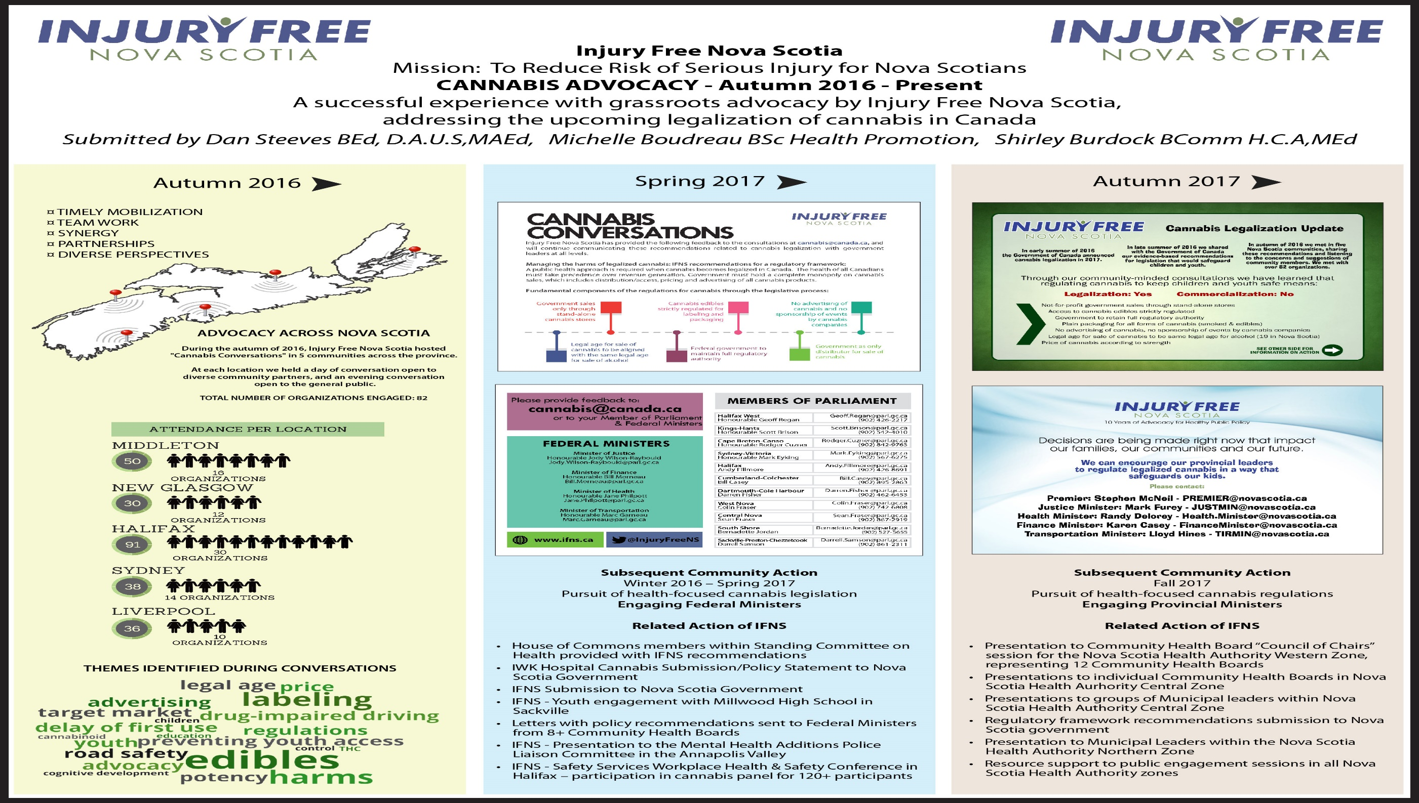

Slide 8
WORKING ON THE TOP ISSUES OF SERIOUS INJURY AND DEATH IN NOVA SCOTIA
ROAD SAFETY
FALLS
SUICIDE

Slide 9

Road Safety Advisory Committee
For the past 8 years Injury Free Nova Scotia has participated in the multi-disciplinary provincial Road Safety Advisory Committee. For the past 6 years we have also participated as the community co-chair within that committee, together with the government co-chair from the Department of Transportation and Infrastructure Renewal.
Within this committee role we work to identify and provide recommendations to government on pressing issues of road safety, - identifying areas of legislative change that evidence indicates will lessen injury severity and save lives. We also provide support to government by gathering evidence on emergent issues that will support informed decision-making.
And importantly, this committee also provides the opportunity for each organization to learn from the others, and collaborate on shared road safety concerns in ways that will enhance individual organization efforts.

Slide 10
FALLS
The issue of falls continues to be a challenging one to Nova Scotians, as it remains one of the top three causes of serious injury and death across the lifespan.
The issue of falls continues to be a challenging one to the Nova Scotia health care system, as it accounts for a significant cost to the system.
Primary engagement for us in the issue of falls continues to be in our policy work related to substance use, such as with alcohol, cannabis and opiates. It also links with our work in suicide prevention.
Secondary engagement for us is in support of the partners creating and delivering falls prevention education, and in support of those creating falls prevention policies, across the lifespan. Addressing issues of built environment continues to be an important facet in effective falls prevention

Slide 11
SUICIDE
Suicide and suicide attempts remain one of the top three causes of death and serious injury in Nova Scotia. We believe strongly that preventing suicides requires a mobilized and supportive partnership of clinical services and community engagement. Our suicide prevention activities continue to move forward on a number of fronts.
Through involvement with the Annapolis Valley CAST (Communities addressing Suicide Together)committee we support ongoing community resiliency in addressing the issue.
We continue to be a planning partner for the annual AV CAST Conference.
Work we undertake on the issue of substances, including alcohol, cannabis, opiates and others, seeks to create healthy public policy that results in lower levels of serious injury and deaths, including those by suicide. Work we undertake in all areas of road safety also seeks to create road safety policy that lowers levels of suicide-related collisions.

Slide 12
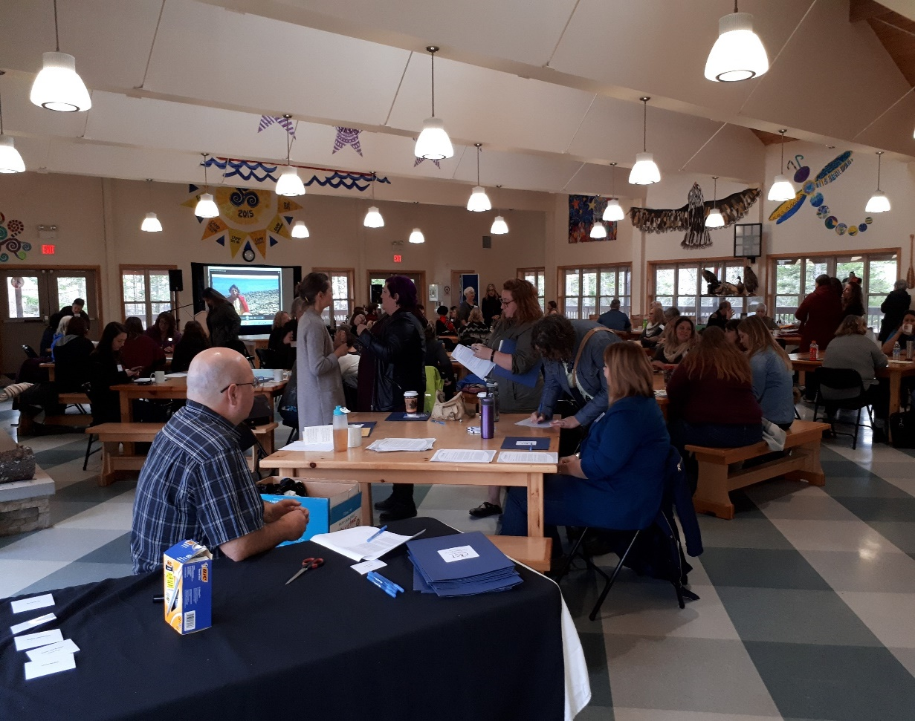
Annapolis Valley CAST Conference
“Peer Support and Life Promotion”
Brigadoon Village, November 17, 2017

Slide 13
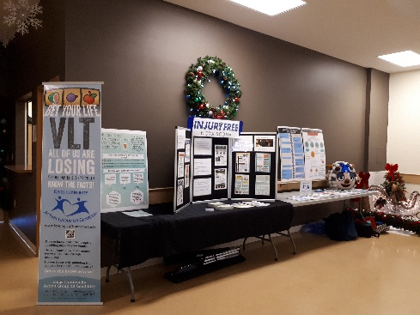

PARTNERSHIPS on ISSUES OF INJURY
GAMBLING HARMS – We have carried out ongoing work with the Kings Community Action Group on Gambling to raise awareness of the community harms that come from Video Lottery Terminals.
ALCOHOL – We have carried out ongoing work with the Community Alcohol Project to raise awareness of the community harms that come from risky alcohol consumption, especially to our children and youth.

Slide 14
SUPPORTING INJURY PREVENTION ACROSS ATLANTIC CANADA
Injury Free Nova Scotia continues its ongoing involvement in the Atlantic Collaborative on Injury Prevention (ACIP) and over the past 5 years has participated on the executive team as vice-chair. With a collaborative focus, ACIP works to prevent and reduce the impact of injuries in Atlantic Canada.
ACIP has representation from each of the four Atlantic Provinces, with government, non-government and community-based involvement. Through our work with ACIP we support injury prevention initiatives across Atlantic Canada, pursuing needed evidence and sharing best practices.

Slide 15
FINANCIAL REPORT
See Attachment

